Slide 1

Wear′s the Party!
Paul Lammertsma
CTO, Pixplicity

Slide 2
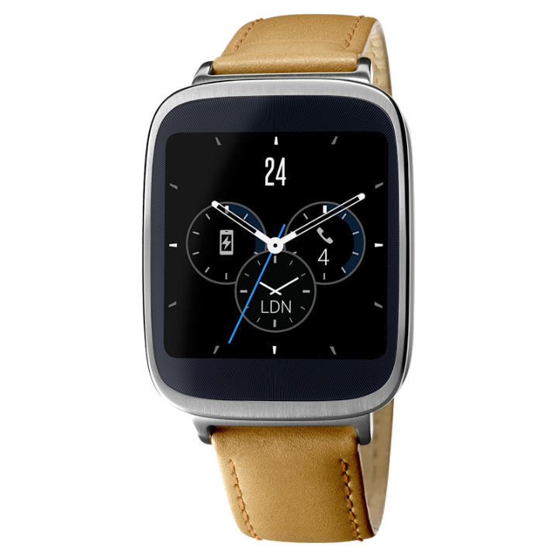
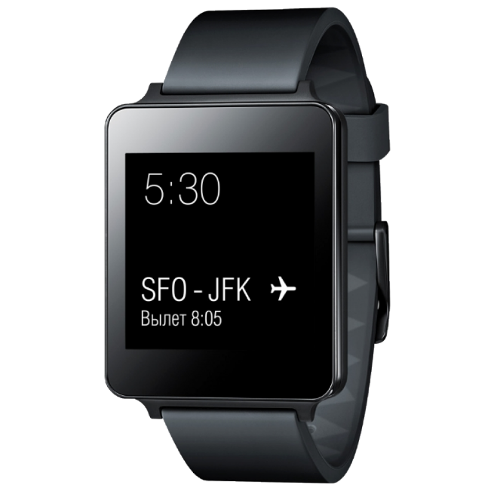
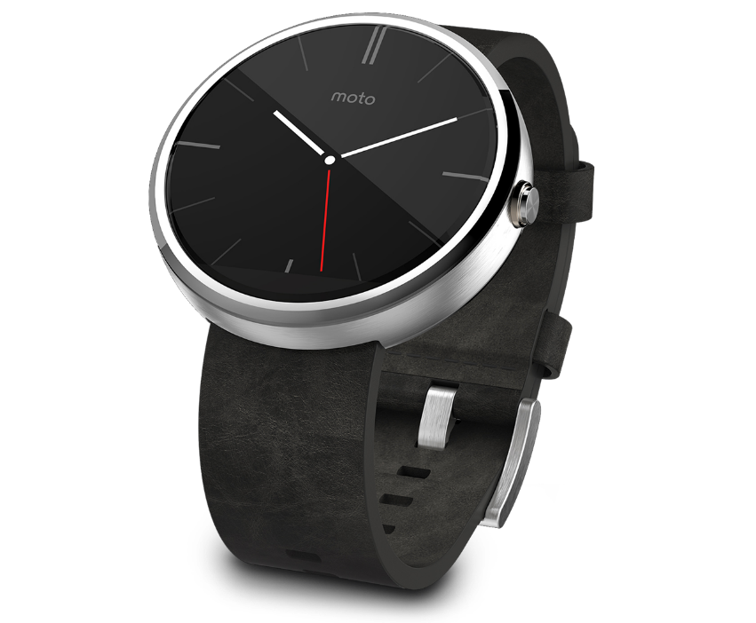
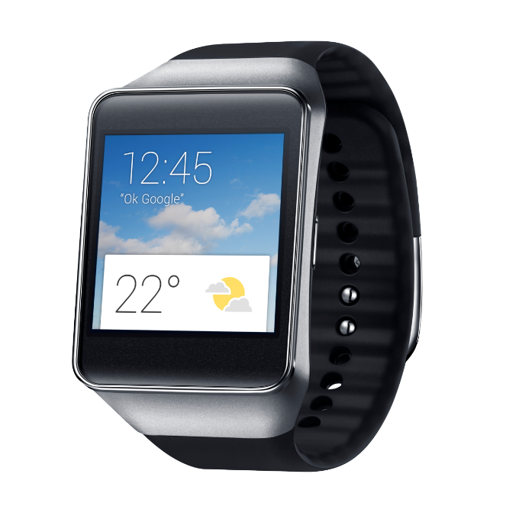
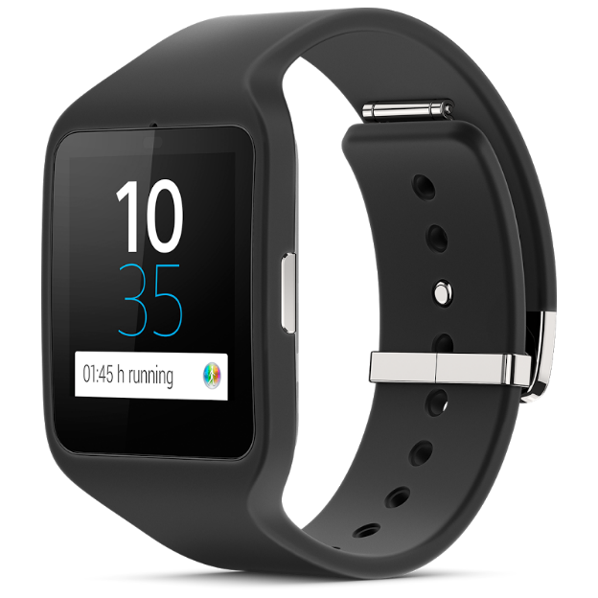
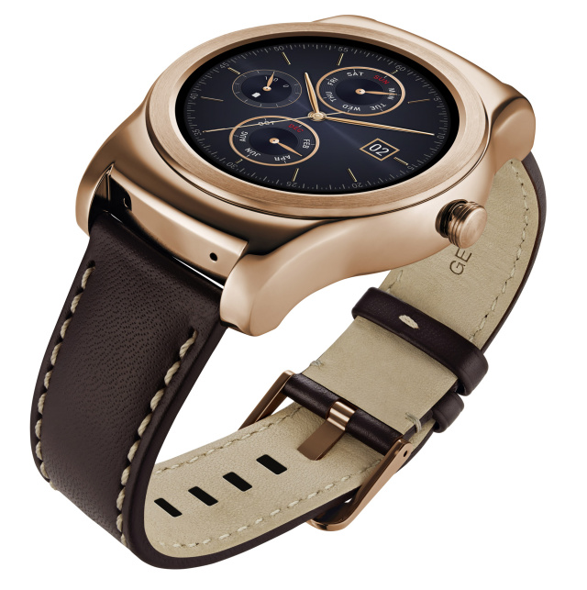
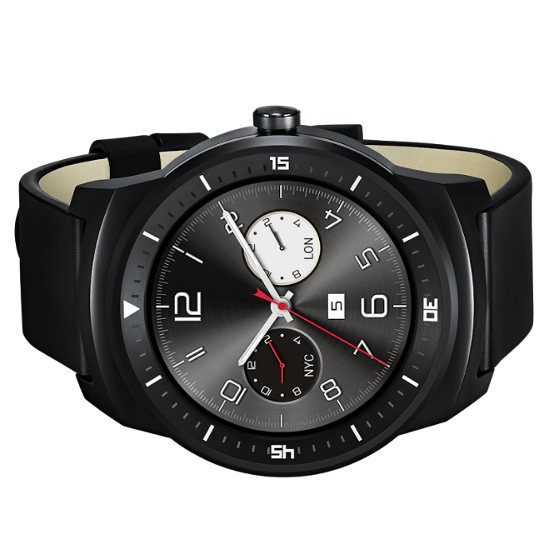
Notes:
The party started in March 2014.
Left to right: Sony Smartwatch 3, Samsung Gear Live, Asus Zenwatch, LG G Watch, LG Watch Urbane, Motorola Moto 360, (front) LG G Watch R

Slide 3
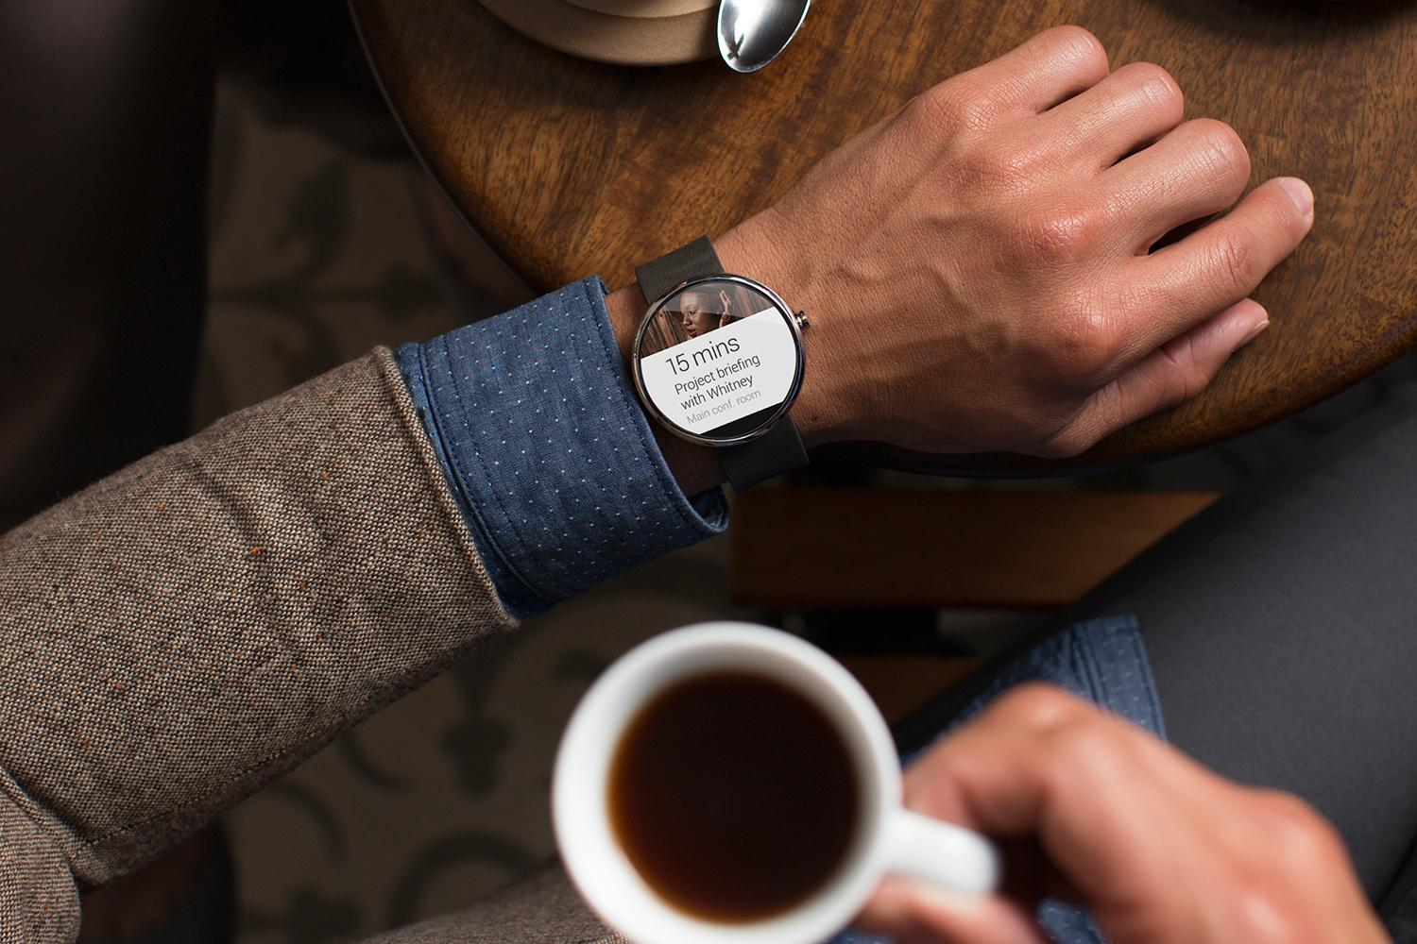
Short demo

Slide 4

Creative vision

Slide 5
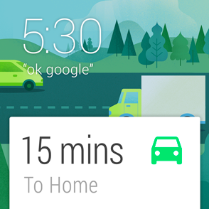
Launched automatically
Cards appear on the stream when they become relevant
“Android Wear is timely, relevant and very specific.”
Notes:
“Android Wear is timely, relevant and very specific.”

Slide 6
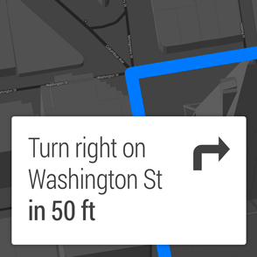
Glanceable
See information in a split second
“Android Wear is fast, sharp, and immediate.”
Notes:
“Android Wear is fast, sharp, and immediate.”

Slide 7
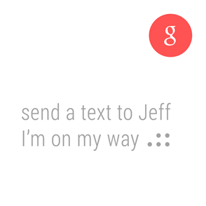
Suggest and demand
Only interrupts you when necessary and always on hand to provide an answer
“Android Wear is helpful, respectful, and responsive.”
Notes:
“Android Wear is helpful, respectful, and responsive.”

Slide 8
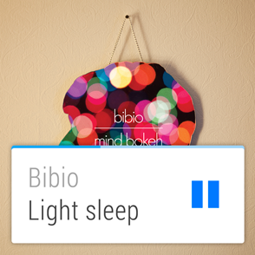
Zero or low interaction
Input rarely needed, and avoids fine-grained finger movements
“Android Wear is gestural, simple, and fast.”
Notes:
“Android Wear is gestural, simple, and fast.”

Slide 9

Under the hood

Slide 10
It’s Android
Android-powered wearable on your wrist
Running 5.0 Lollipop
Specially designed apps for Wear

Slide 11
It’s not a replacement
Connected to phone or tablet
Portal to the internet
Mirrors notifications

Slide 12

Watchfaces Notifications Wear apps

Slide 13
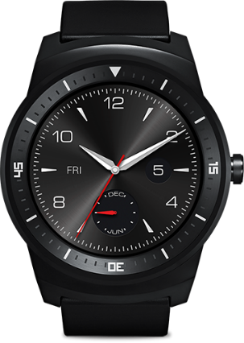
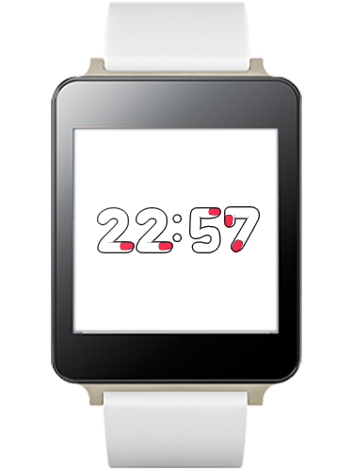
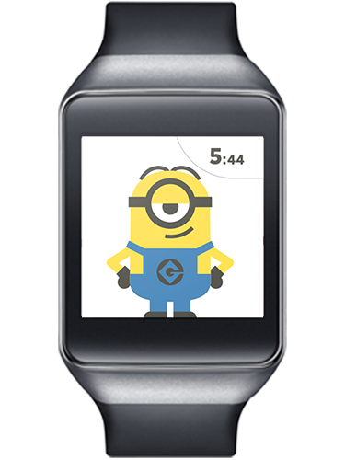
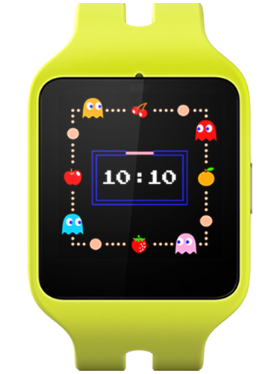
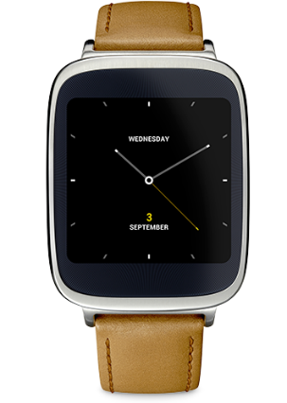
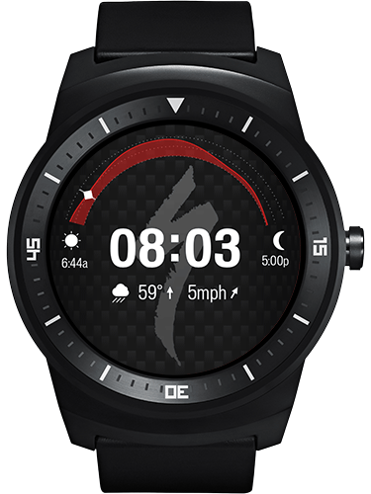
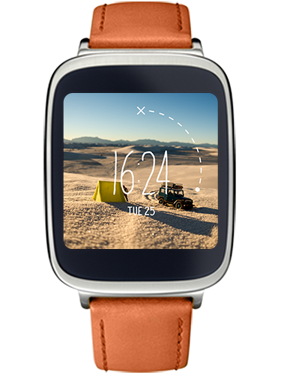
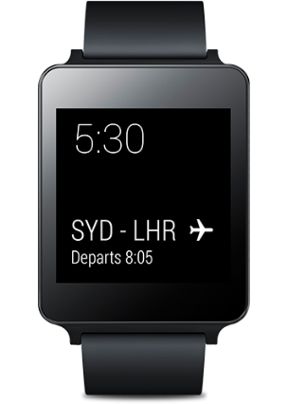
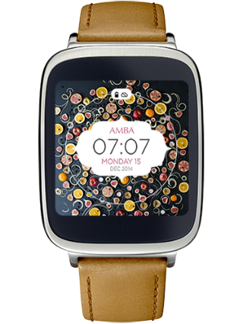
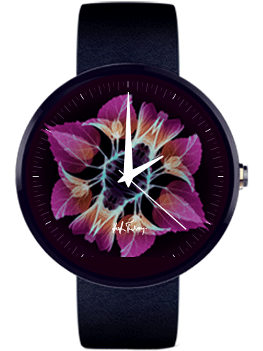
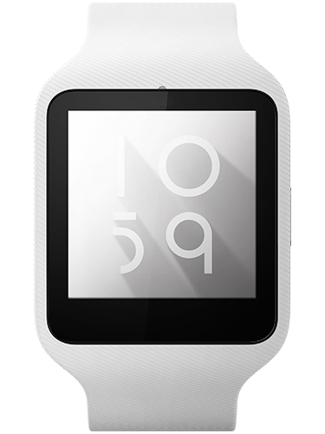
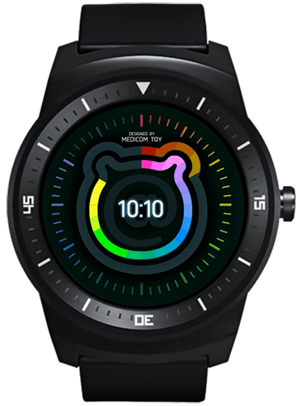
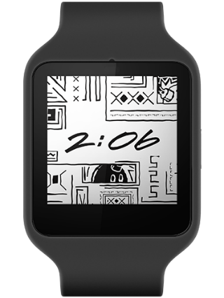
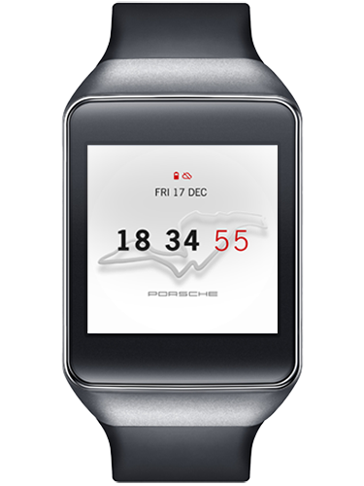
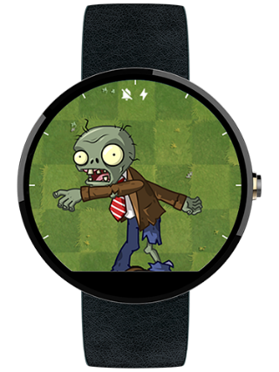
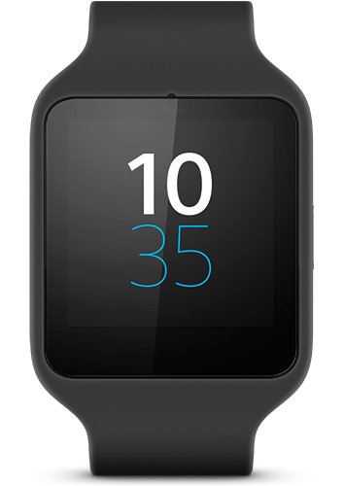
Watchfaces
Notes:
Custom watchfaces.

Slide 14
Watchfaces
Until Lollipop, no standard
Draws on a OpenGL-backed canvas inside a Service

Slide 15
Notifications

Slide 16
Notifications
AppCompat notifications work “out of the box”

Slide 17
Wear apps

Slide 18
Wear apps
APK for Wear is bundled inside the mobile’s APK
Enhanced with:
Pages
Actions
Replies
Custom backgrounds

Slide 19
Wear apps
http://developer.android.com/design/wear/principles.html
http://developer.android.com/design/wear/structure.html

Slide 20
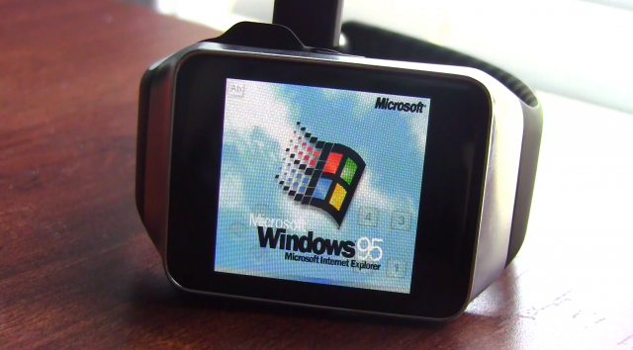
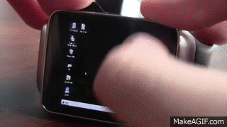
…and more!

Slide 21
Debugging
Attach the watch via USB
Enable debugging on the wearable:
Tap the home screen twice to bring up the Wear menu.
Scroll to the bottom and tap Settings.
Scroll to the bottom and tap the Developer Options. If there's no Developer Options item, tap About, and then tap the build number 7 times.
Enable ADB debugging.

Slide 22
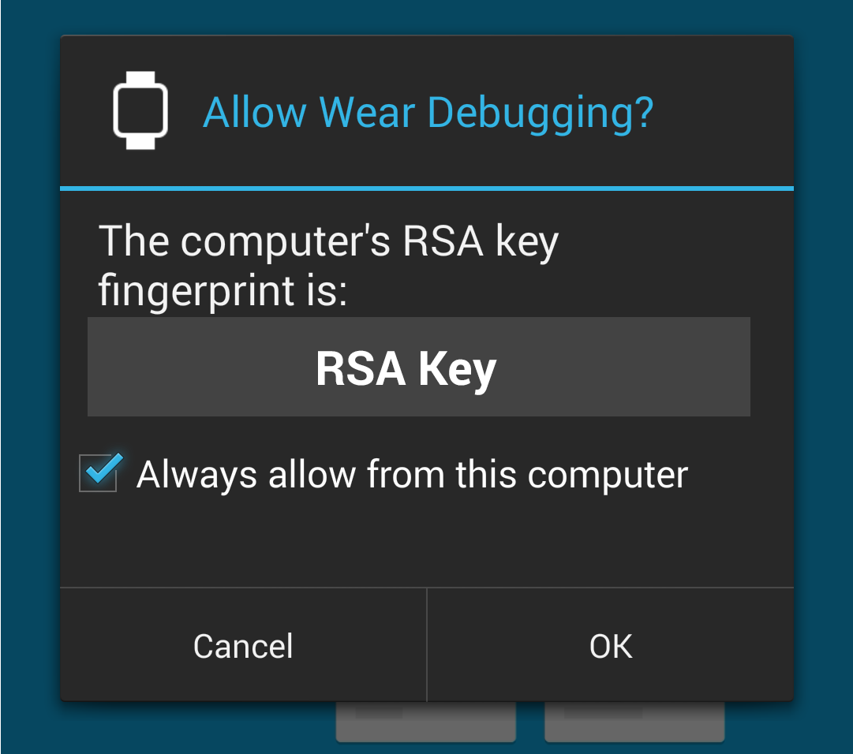
Debugging
Approve your computer’s RSA signature in the pop-up on your phone

Slide 23
Debugging over Bluetooth
Enable Bluetooth debugging on the wearable:
Tap the home screen twice to bring up the Wear menu.
Scroll to the bottom and tap Settings.
Scroll to the bottom and tap the Developer Options. If there's no Developer Options item, tap About, and then tap the build number 7 times.
Enable Debug over Bluetooth.

Slide 24
Debugging over Bluetooth
Connect the handheld to your machine over USB
Run: adb forward tcp:4444 localabstract:/adb-hub adb connect localhost:4444
Approve your computer’s RSA signature in the pop-up on your phone

Slide 25
Tips
Use a common project to share constants between your wear and handheld

Slide 26
Gotchas!

Slide 27
Useful stuff

Slide 28
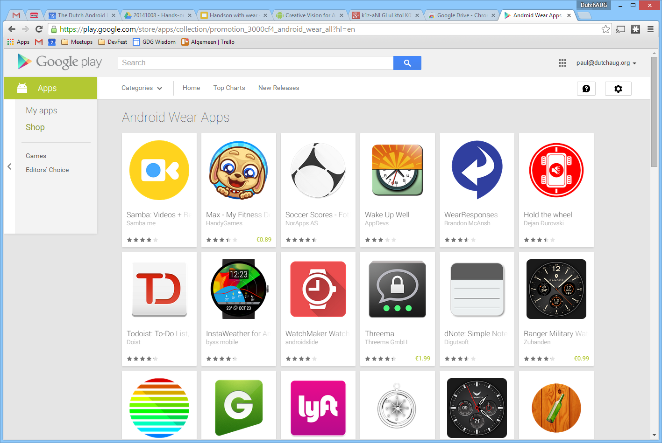
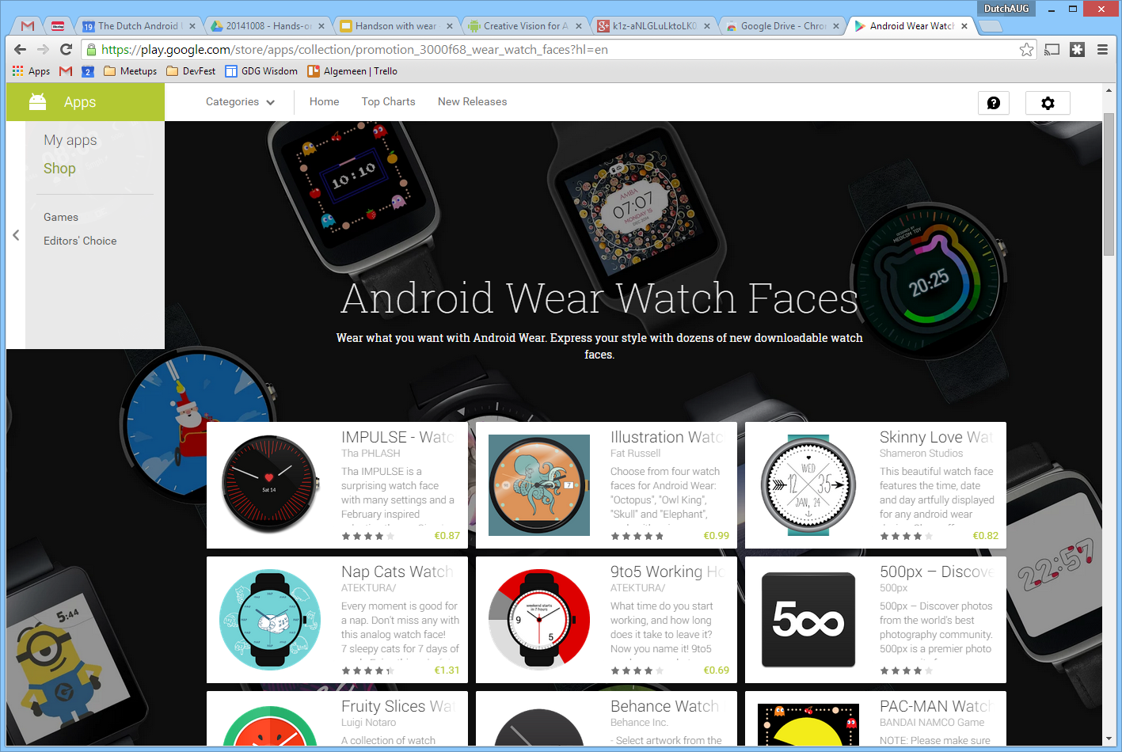
Added value

Slide 29
Wear′s the Party!
Source code & slides: http://github.com/Pixplicity/weardemo
Paul Lammertsma
CTO, Pixplicity
@officesunshine

